Slide 1
DB
Relational database 1ST NORMAL FORM

Slide 2


Slide 3
CHOOSE THE RIGHT ANSWER
Q1. which one has got relation many to many?
Students & Course
Customers and Products
Book and Author
All of above are correct
Q2. To manage relation many to many, you need to create an intersection table.
False
True

Slide 4
Q3. What is ERD stand for?
ERD stand for Entity Relationship Diagram.
ERD stand for Entity Relationship Database.
ERD stand for Entity Relationship Dolphins.
Q4. You can get data from a record table by using primary key.
True
False

Slide 5
Q5. There are three types of relation in ERD.
Zero to one, one to one, one to many
One to one, one to many, many to many
One to one , one to many, many to zero
Q6. Primary Key and Foreign Key are the same.
False
True

Slide 6
Q7. A primary key is used to ensure data in the specific column is unique.
True
False
Q8. Foreign key refers to the field in a table which is the primary key of another table.
False
True

Slide 7
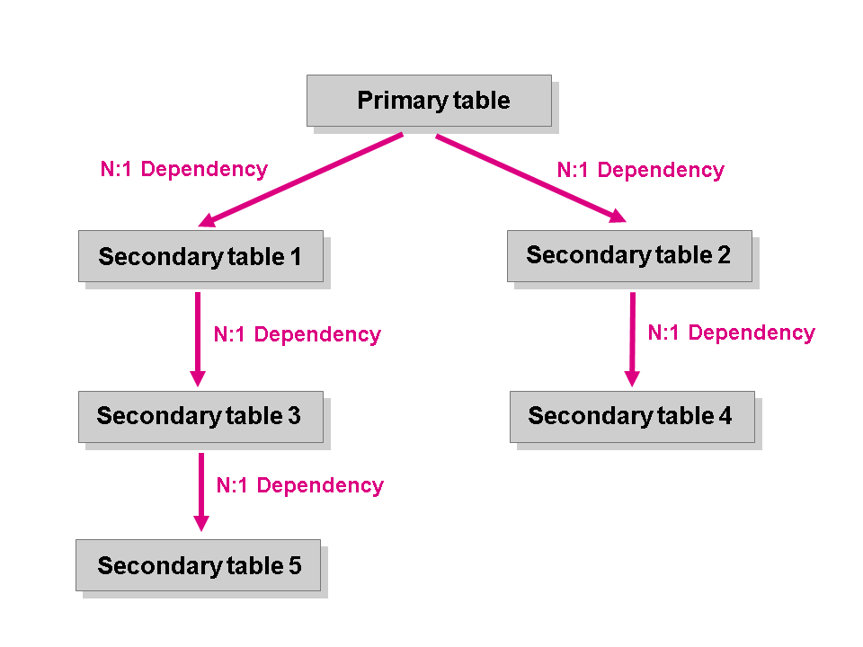

Q9. This is an ERD.
True
False

